Slide 1
MongoDB
Lecturer: Ngo Huy Bien
Software Engineering Department
Faculty of Information Technology
VNUHCM - University of Science
Ho Chi Minh City, Vietnam
nhbien@fit.hcmus.edu.vn

Slide 2

Objectives
To configure MongoDB to achieve high availability.
To configure MongoDB to achieve scalability.

Slide 3

Contents
Data Replication Problem.
Data Sharding Problem.
MongoDB Installation.
MongoDB Concetps.
Replication.
Sharding.

Slide 4

References
Bradshaw Shannon, Eoin Brazil and Kristina Chodorow (2019). MongoDB: The Definitive Guide - Powerful and Scalable Data Storage. O'Reilly Media.

Slide 5

Solving a Problem: The Hard Part
Input:
Story: As sponsors, we want the system data to be stored on 2 database servers so that we can ensure that our data is safe from a server crash.
Developer: Ngo Huy Bien.
Bonus:
Prototype, Architecture, Proof of Concept.
Scenarios, Domain Models.
ERD
Output:
Source code → Problem solved.
Issue: Which tools? I haven't used these tools.

Slide 6


Why Learn a New Tool?
1
Make money
Get a job (job requirement)
Startup (solving a problem)
Tool selection
Faster development (Get a task done).
Easier modifiability and extensibility.
Better security and scalability.
Hobby
Problem/need.
Open yourself up to new ideas and approaches.
2

Slide 7


Identify a Concrete Problem
Configure data replication for mongoDB.
Configure data sharding for mongoDB.

Slide 8

Typical Procedure
Clarify domain-specific terminologies (Data replication? Data sharding?, mongoDB? Casandra?)
Find a tutorial (or a mentor).
Install, configure and use the tool.
Test results.

Slide 9
DB High Availability Example
User (SPA) ---> Web server (API) ---> Database server.
User (Brower) ---> Web server (MPA/API) ---> Database server.
User (Native mobile app) ---> Web server (API) ---> Database server.
User (SPA) ---> Web server (API) ---> Database server 1 ---> Down.
(automated) ---> Database server 2 (Backup, Up)

Slide 10
DB High Availability Approach
User (SPA) ---> Web server (API) ---> Database server 1 ---> Down.
(automated) ---> Database server 2 (Backup, Up)
---
Approach:
Replication/Synchronization --> Tool? --> How?
MongDB
MS SQL, Oracle.
Mechanism -> Switching 1 -> 2 --> Tool? --> How?
Ubuntu: less issues.

Slide 11
DB Scalability Example
User (SPA) ---> Web server (API) ---> Database server 1. (X)
(automated) ---> Database server 2, 3 (backup)
(1 - 500.000) -id
---> Database server 4. (X)
---> Database server 5, 6 (backup)
(500.001 - 1.000.000) -id

Slide 12
DB Scalability Approach
User (SPA) ---> Web server (API) ---> Database server 1. (X)
(automated) ---> Database server 2, 3 (backup)
(1 - 500.000) -id
---> Database server 4. (X)
---> Database server 5, 6 (backup)
(500.001 - 1.000.000) -id
---
Approach:
Developers: Install and configure software.
Concepts: Configuration server, Replica, Hashed key.

Slide 13


Slide 14
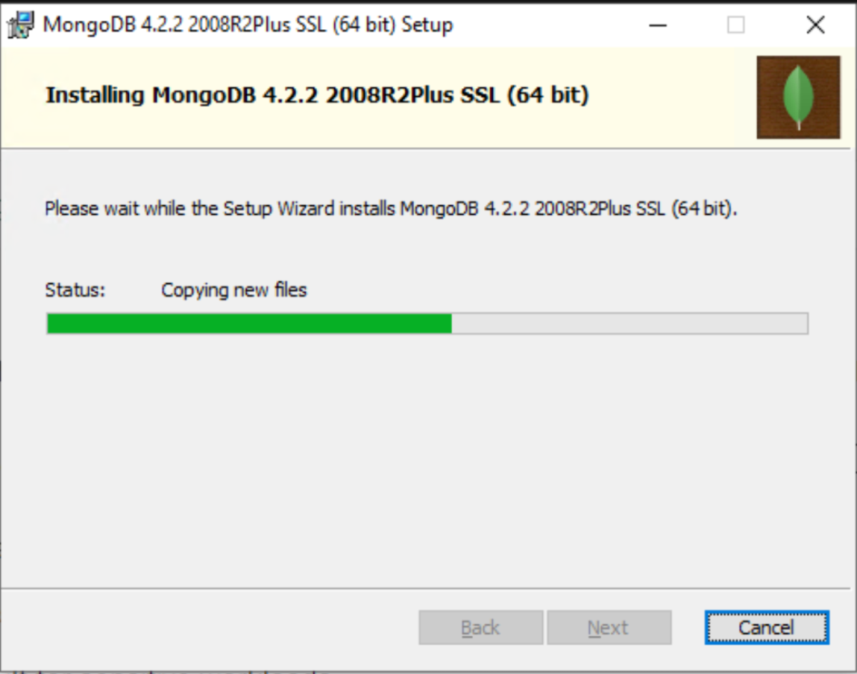
1. Install MongoDB on Windows
https://docs.mongodb.com/manual/tutorial/install-mongodb-on-windows/
Add “C:\Program Files\MongoDB\Server\4.4\bin” to your PATH.

Slide 15
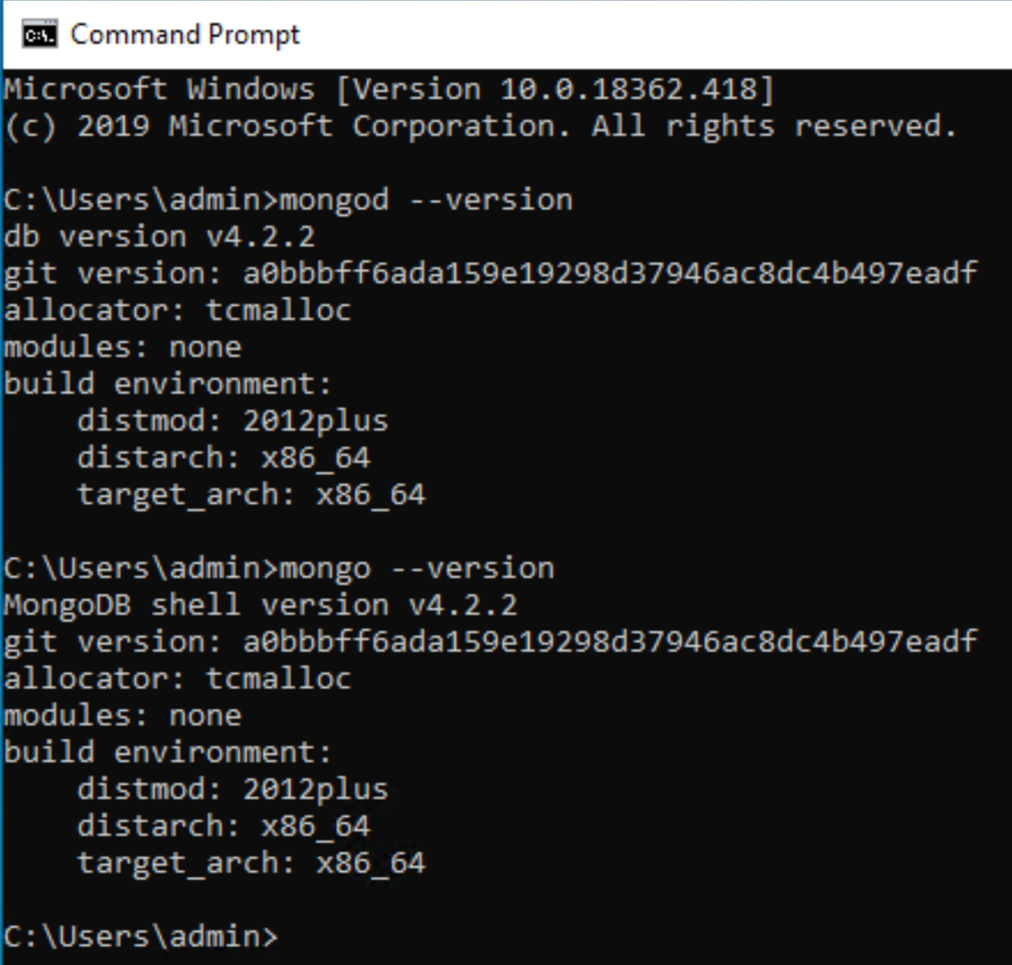
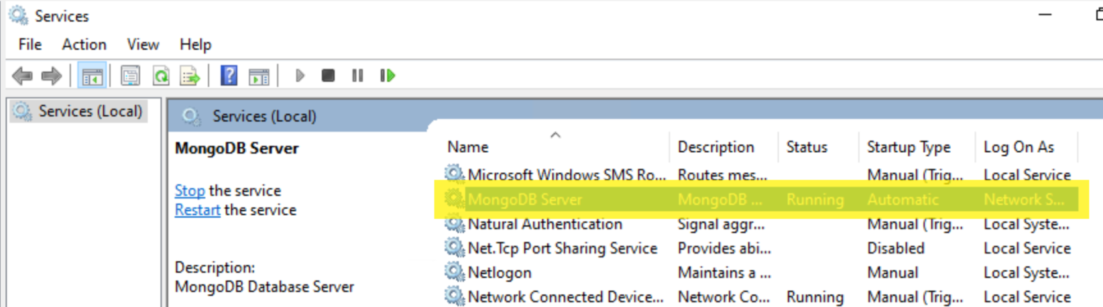
2. Test MongoDB Installation
mongod --version
mongo --version

Slide 16
3. Start MongoDB Server
https://docs.mongodb.com/manual/tutorial/manage-mongodb-processes/
Create data directory
mkdir C:\data\db
Start a server on 27017 port
mongod --dbpath C:\data\db
Allow remote connections
mongod --dbpath C:\data\db --port 27017 --bind_ip 0.0.0.0

Slide 17
4. Connect to a MongoDB Server
Connect to a local server
mongo
List your current database
db
View all available databases
show dbs
Connect to remote server
mongo --host 192.168.1.22 --port 27017

Slide 18
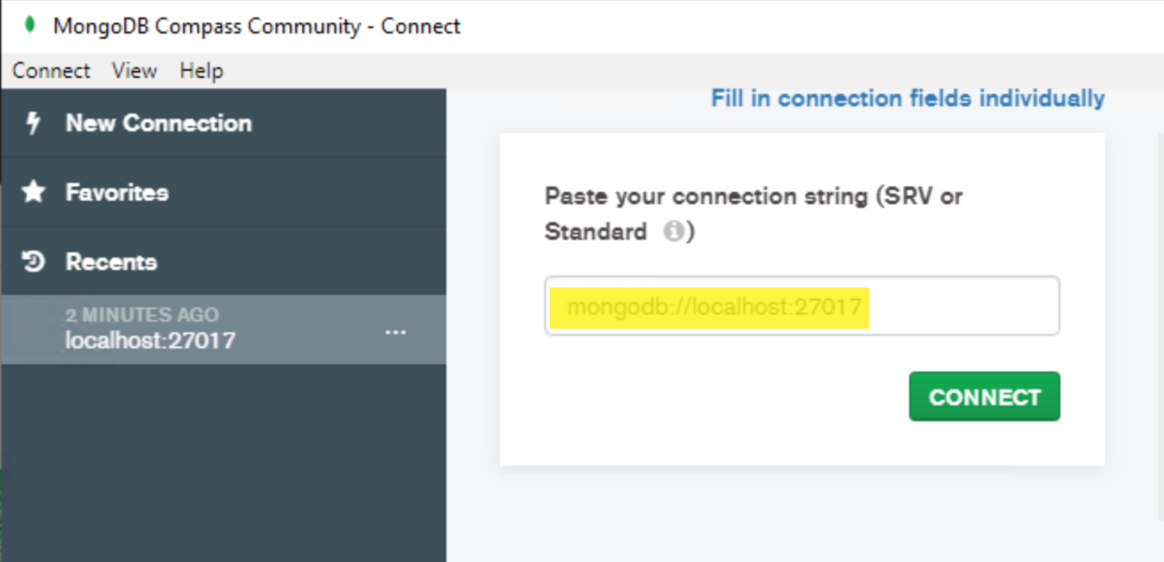
5. Open MongoDB Compass
By default mongodb does not enable access control, so there is no default user or password.

Slide 19
6. Insert and Retrieve Data
To create a database
use new_test_db
To add data to the database
db.contacts.insert({
name: "Jon Wexler",
email: "jon@jonwexler.com",
note: "Decent guy."
})
db.contacts.insert({first_name: "Jon", favoriteSeason: "spring", countries_visited: 42})
db.contacts.find()

Slide 21
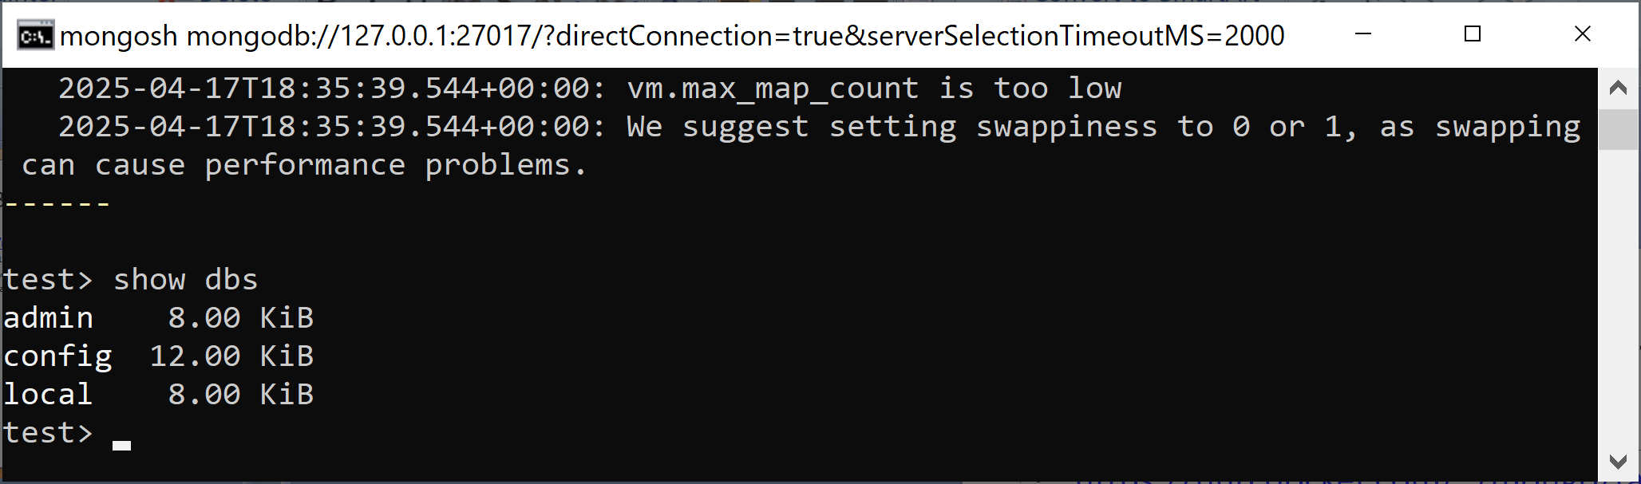
1. Run MongoDB Container
https://hub.docker.com/_/mongo/tags
docker run -d --name test-mongo -p 27017:27017 mongo:8.0.1
docker exec -it test-mongo bash
mongosh
show dbs

Slide 22
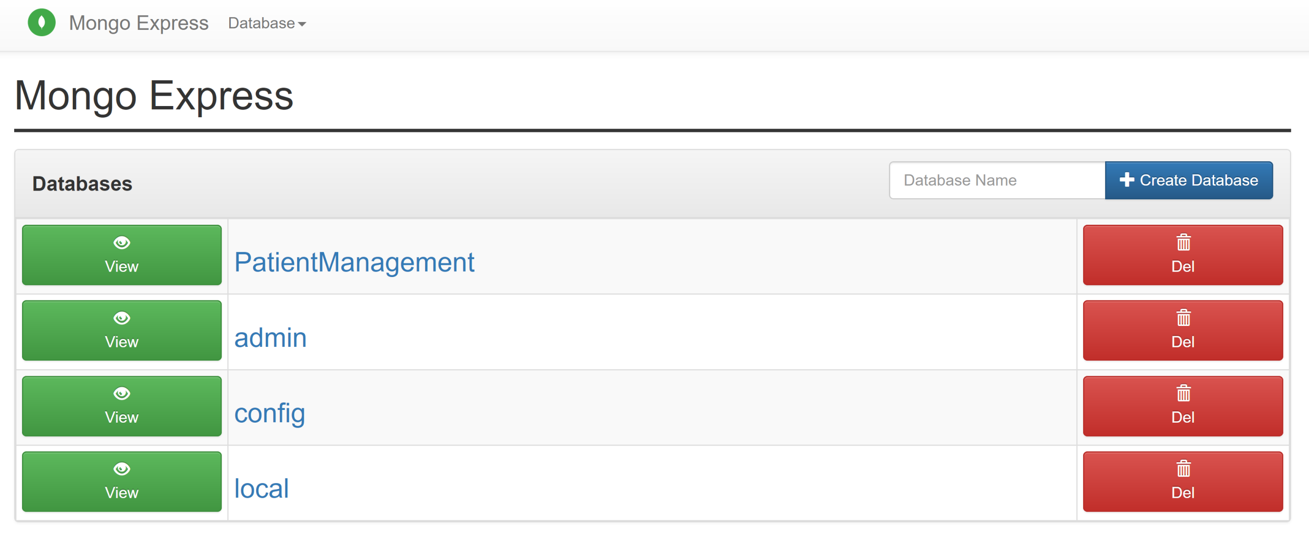
2. Run Mongo Express Container
https://hub.docker.com/_/mongo-express
docker run -d -p 8081:8081 --link test-mongo:mongo -e ME_CONFIG_MONGODB_URL="mongodb://mongo:27017" mongo-express
http://127.0.0.1:8081 ( admin / pass )

Slide 24
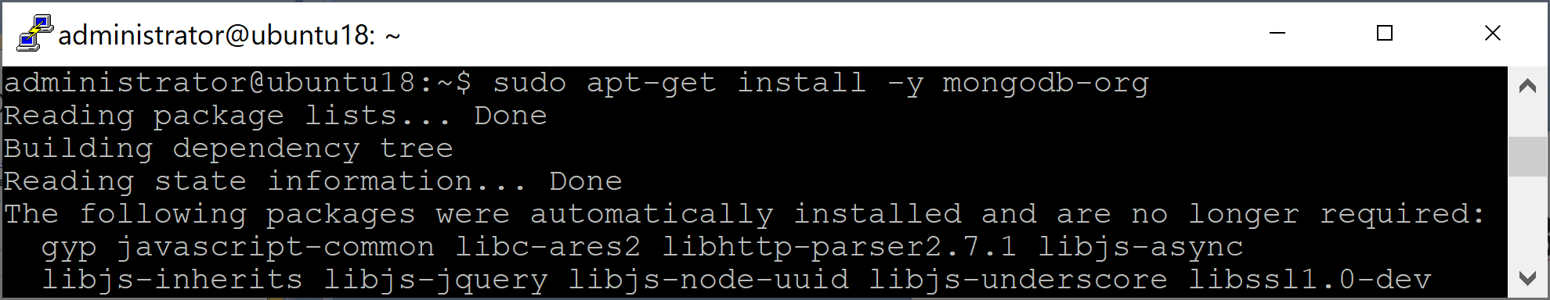
1. Install MongoDB on Ubuntu
https://docs.mongodb.com/manual/tutorial/install-mongodb-on-ubuntu/
Import the public key used by the package management system.
wget -qO - https://www.mongodb.org/static/pgp/server-4.4.asc | sudo apt-key add -
Create a list file for MongoDB.
echo "deb [ arch=amd64,arm64 ] https://repo.mongodb.org/apt/ubuntu bionic/mongodb-org/4.4 multiverse" | sudo tee /etc/apt/sources.list.d/mongodb-org-4.4.list
Reload local package database.
sudo apt-get update
Install the MongoDB packages.
sudo apt-get install -y mongodb-org

Slide 25
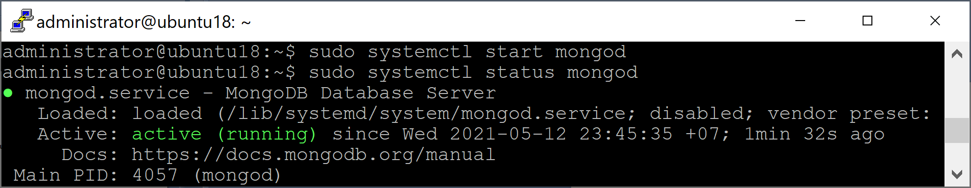
2. Verify MongoDB Installation
Detect init system
ps --no-headers -o comm 1
Start MongoDB.
sudo systemctl start mongod
Verify that MongoDB has started successfully.
sudo systemctl status mongod
Stop MongoDB.
sudo systemctl stop mongod
Restart MongoDB.
sudo systemctl restart mongod
Begin using MongoDB.
mongo

Slide 27
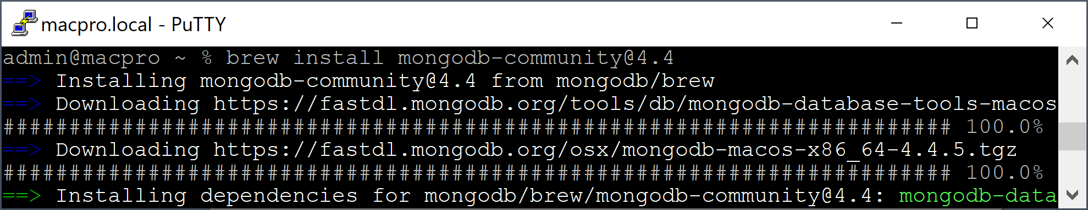
1. Install MongoDB on macOS
https://docs.mongodb.com/manual/tutorial/install-mongodb-on-os-x/
Install the Xcode command-line tools.
xcode-select --install
Install Homebrew
/bin/bash -c "$(curl -fsSL https://raw.githubusercontent.com/Homebrew/install/HEAD/install.sh)"
Download the official Homebrew formula for MongoDB and the Database Tools. Homebrew Formulae is an online package browser for Homebrew – the macOS (and Linux) package manager.
brew tap mongodb/brew
Install MongoDB
brew install mongodb-community@4.4

Slide 28
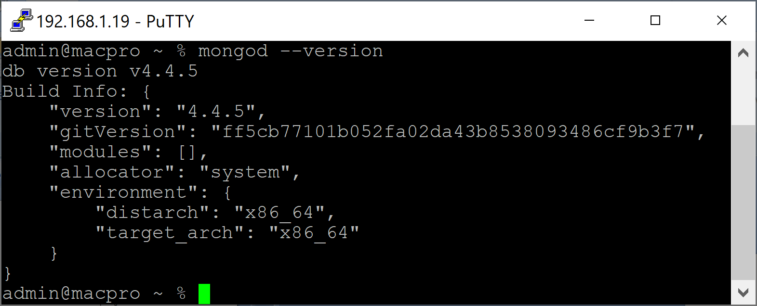
2. Verify MongoDB Installation
mongod --version

Slide 30
Documents [1]
Document: an ordered set of keys with associated values.
Examples
{"greeting" : "Hello, world!"}
{"greeting" : "Hello, world!", "views" : 3}
Documents in MongoDB cannot contain duplicate keys.
{"greeting" : "Hello, world!", "greeting" : "Hello, MongoDB!"} (invalid document)
A document is the MongoDB analog of a row in a relational database.

Slide 31
Collections
A collection is a group of documents.
A collection can be thought of as the analog to a table row in a relational database.
Collections have dynamic schemas. This means that the documents within a single collection can have any number of different “shapes.”
Examples:
{"greeting" : "Hello, world!", "views": 3}
{"signoff": "Good night, and good luck"}

Slide 32
Databases
MongoDB groups collections into databases.
A single instance of MongoDB can host several databases, each grouping together zero or more collections.
There are also some reserved database names
admin
local
config

Slide 33
Working with Databases
Show current database
db
Switch to another database
use admin
use test

Slide 34
Working with Collections
Drop a collection
use test
db.users.drop();

Slide 35
_id
Every document stored in MongoDB must have an "_id" key.
The "_id" key’s value can be any type, but it defaults to an ObjectId.
In a single collection, every document must have a unique value for "_id", which ensures that every document in a collection can be uniquely identified.

Slide 36
ObjectId
ObjectId is the default type for "_id".
The ObjectId class is designed to be lightweight, while still being easy to generate in a globally unique way across different machines.
MongoDB’s distributed nature is the main reason why it uses ObjectIds as opposed to something more traditional, like an autoincrementing primary key: it is difficult and time-consuming to synchronize autoincrementing primary keys across multiple servers.
Because MongoDB was designed to be a distributed database, it was important to be able to generate unique identifiers in a sharded environment.
ObjectIds use 12 bytes of storage, which gives them a string representation that is 24 hexadecimal digits: 2 digits for each byte.

Slide 37
Working with Documents (I)
use test
db.users.insert({"email": "email0", "password": "password0"})
db.users.insert({"email": "email" + 1, "password": "password" + 1})
for (i=2; i<1000; i++) {db.users.insert({"email": "email" + i, "password": "password" + i})}
db.users.count()
db.users.find()
db.users.remove({})

Slide 38
Working with Documents (II)
use test
db.users.insert({"_id": 0, "email": "email0", "password": "password0"})
db.users.insert({"_id": 1, "email": "email" + 1, "password": "password" + 1})
for (i=2; i<1000; i++) {db.users.insert({"_id": i, "email": "email" + i, "password": "password" + i})}
db.users.count()
db.users.find()
db.users.remove({})

Slide 40
Programming
Refer to the Web Application Development course.
10.2. Node.js and MongoDB.pptx

Slide 42
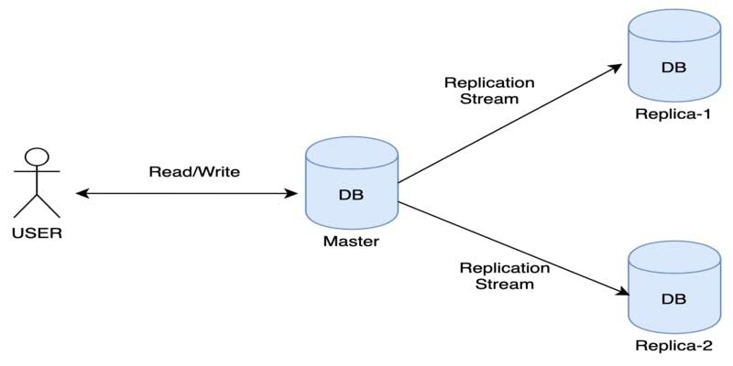
What is Replication? [1]
Replication is a way of keeping identical copies of your data on multiple servers and is recommended for all production deployments.

Slide 43
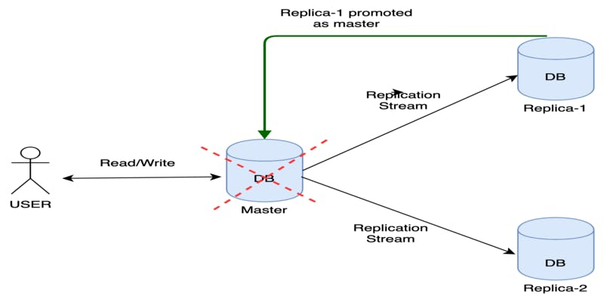
Why Replication (I)
With MongoDB, you set up replication by creating a replica set.
A replica set is a group of servers with one primary, the server taking writes, and multiple secondaries, servers that keep copies of the primary’s data.
If the primary crashes, the secondaries can elect a new primary from amongst themselves.

Slide 44
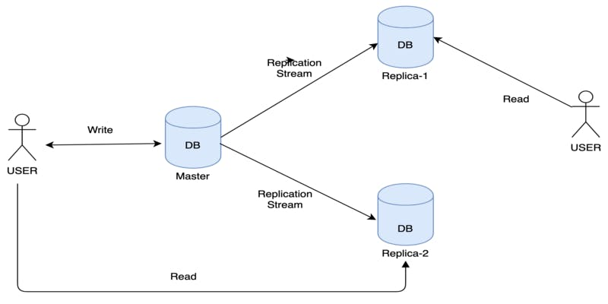
Why Replication (II)
Improve performance using replicas

Slide 45
1. Clean Everything Up
In Windows
net stop MongoDB
In Ubuntu
sudo -s
echo "killing mongod and mongos"
killall mongod
killall mongos
echo "removing data files"
rm -rf /data/rs*

Slide 46
2. Create Folders
In Windows
md c:\data\rs1 c:\data\rs2 c:\data\rs3
In Ubuntu
mkdir /data
mkdir /data/rs1 /data/rs2 /data/rs3

Slide 47
3. Start Servers on Windows
Use Run as Administrator.
mongod --bind_ip localhost --replSet testRS --dbpath c:\data\rs1 --port 27017 --oplogSize 200
mongod --bind_ip localhost --replSet testRS --dbpath c:\data\rs2 --port 27018 --oplogSize 200
mongod --bind_ip localhost --replSet testRS --dbpath c:\data\rs3 --port 27019 --oplogSize 200
Replication is concerned with keeping an identical copy of data on multiple servers.
The way MongoDB accomplishes this is by keeping a log of operations, or oplog, containing every write that a primary performs.
--oplogSize: Specifies a maximum size in megabytes for the replication operation log

Slide 48
3. Start Servers on Ubuntu
sudo mongod --bind_ip localhost --replSet testRS --dbpath /data/rs1 --port 27017 --oplogSize 200
sudo mongod --bind_ip localhost --replSet testRS --dbpath /data/rs2 --port 27018 --oplogSize 200
sudo mongod --bind_ip localhost --replSet testRS --dbpath /data/rs3 --port 27019 --oplogSize 200

Slide 49
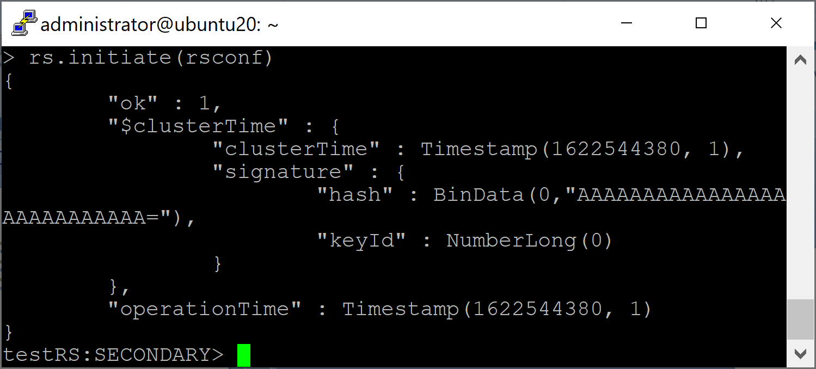
4. Initiate a Replica Set
mongo --port 27017
rsconf = {
_id: "testRS",
members: [
{_id: 0, host: "localhost:27017"},
{_id: 1, host: "localhost:27018"},
{_id: 2, host: "localhost:27019"}
]
}
rs.initiate(rsconf)
rs.status()

Slide 50
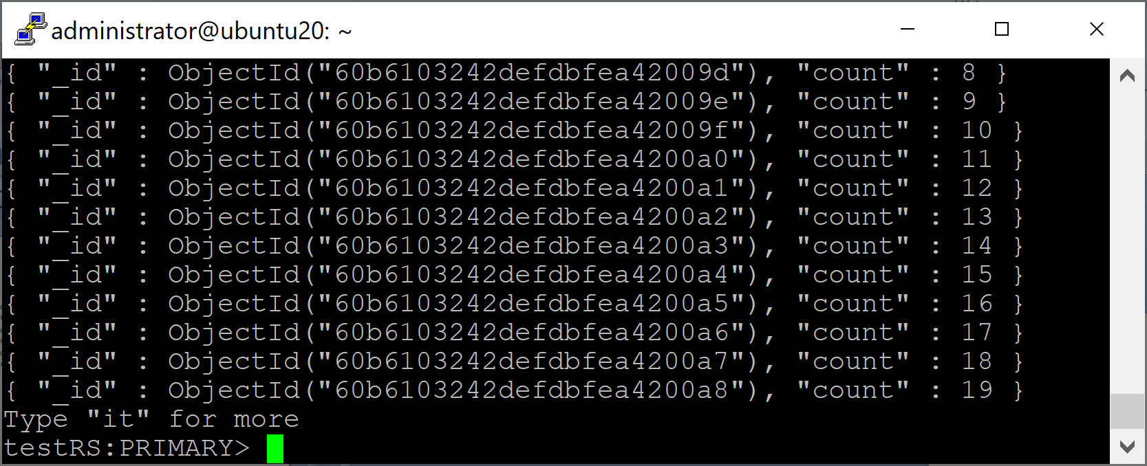
5. Write Data
use test
for (i=0; i<1000; i++) {db.testRS.insert({count: i})}
db.testRS.count()
db.testRS.find()

Slide 51
6. Verify Data Replication
mongo --port 27018
use test
db.testRS.find()
Secondaries may fall behind the primary (or lag) and not have the most current writes, so secondaries will refuse read requests by default to prevent applications from accidentally reading stale data.
We can set an “I’m okay with reading from secondaries” flag.
db.setSecondaryOk()
db.testRS.find()
→ Consistency concept

Slide 52
7. Connect to a Replica Set
Connections to a replica set are similar to connections to a single server.
Use the MongoClient class (or equivalent) in your driver and provide a seed list for the driver to connect to.
A seed list is simply a list of server addresses.
When the driver connects to the seeds, it will discover the other members from them. A connection string usually looks something like this
"mongodb://server-1:27017,server-2:27017,server-3:27017"

Slide 54
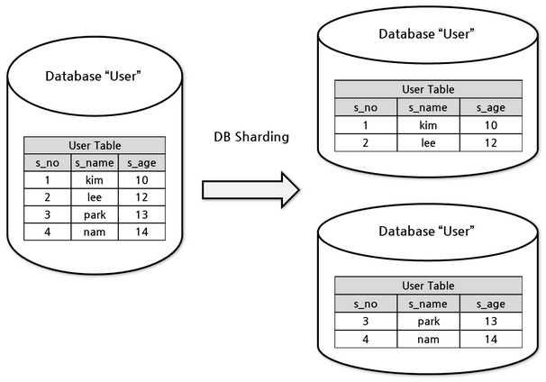
What is Sharding?
Sharding refers to the process of splitting data up across machines; the term partitioning is also sometimes used to describe this concept.

Slide 55
Why Sharding?
By putting a subset of data on each machine, it becomes possible to store more data and handle more load without requiring larger or more powerful machines—just a larger quantity of less powerful machines.
Sharding may be used for other purposes as well, including placing more frequently accessed data on more performant hardware or splitting a dataset based on geography to locate a subset of documents in a collection (e.g., for users based in a particular locale) close to the application servers from which they are most commonly accessed.

Slide 56
Why Not Manual Sharding?
Manual sharding can be done with almost any database software.
With this approach, an application maintains connections to several different database servers, each of which are completely independent.
The application manages storing different data on different servers and querying against the appropriate server to get data back.
This setup can work well but becomes difficult to maintain when adding or removing nodes from the cluster or in the face of changing data distributions or load patterns.

Slide 57
Why Autosharding?
MongoDB supports autosharding, which tries to both abstract the architecture away from the application and simplify the administration of such a system.
MongoDB’s sharding allows you to create a cluster of many machines (shards) and break up a collection across them, putting a subset of data on each shard.
MongoDB automates balancing data across shards and makes it easier to add and remove capacity.

Slide 58
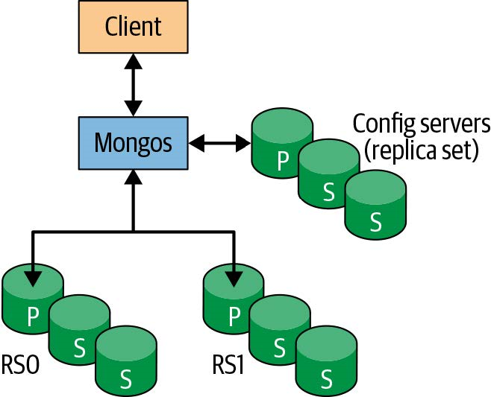
Routing Processes
One of the goals of sharding is to make a cluster of 2, 3, 10, or even hundreds of shards look like a single machine to your application.
To hide these details from the application, we run one or more routing processes called a mongos in front of the shards.
A mongos keeps a “table of contents” that tells it which shard contains which data.
Applications can connect to this router and issue requests normally.

Slide 59
Config Servers
Config servers are the brains of your cluster: they hold all of the metadata about which servers hold what data.
In production deployments, your config server replica set should consist of at least three members.
Each config server should be on a separate physical machine, preferable geographically distributed.

Slide 60
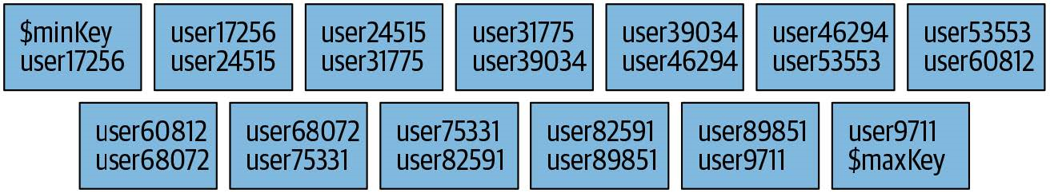
Shard Key
When you shard a collection, you choose a shard key.
This is a field or two that MongoDB uses to break up data.
For example, if you chose to shard on "username", MongoDB would break up the data into ranges of usernames:
"a1-steak-sauce" through "defcon",
"defcon1" through "howie1998", and so on.
Sharding splits the collection into many chunks based on shard key ranges:

Slide 61
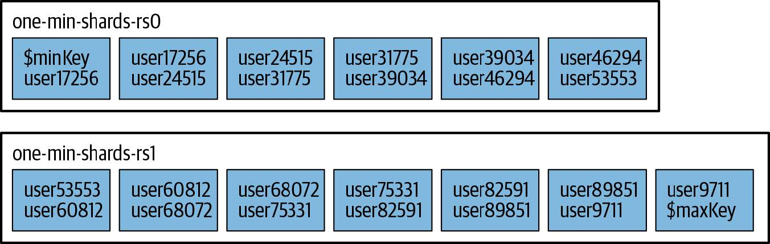
Chunks Distribution
Chunks are evenly distributed across the available shards.

Slide 62
Hashed Shard Key
For loading data as fast as possible, hashed shard keys are the best option.
A hashed shard key can make any field randomly distributed.
The trade-off is that you can never do a targeted range query with a hashed shard key.

Slide 63
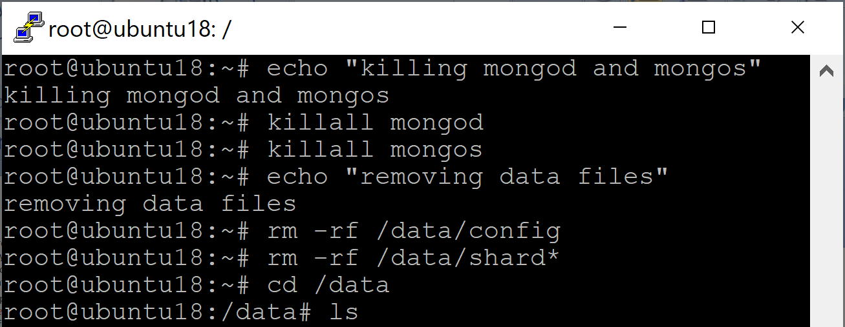
1. Clean Everything Up
sudo -s
echo "killing mongod and mongos"
killall mongod
killall mongos
echo "removing data files"
rm -rf /data/config
rm -rf /data/shard*

Slide 64
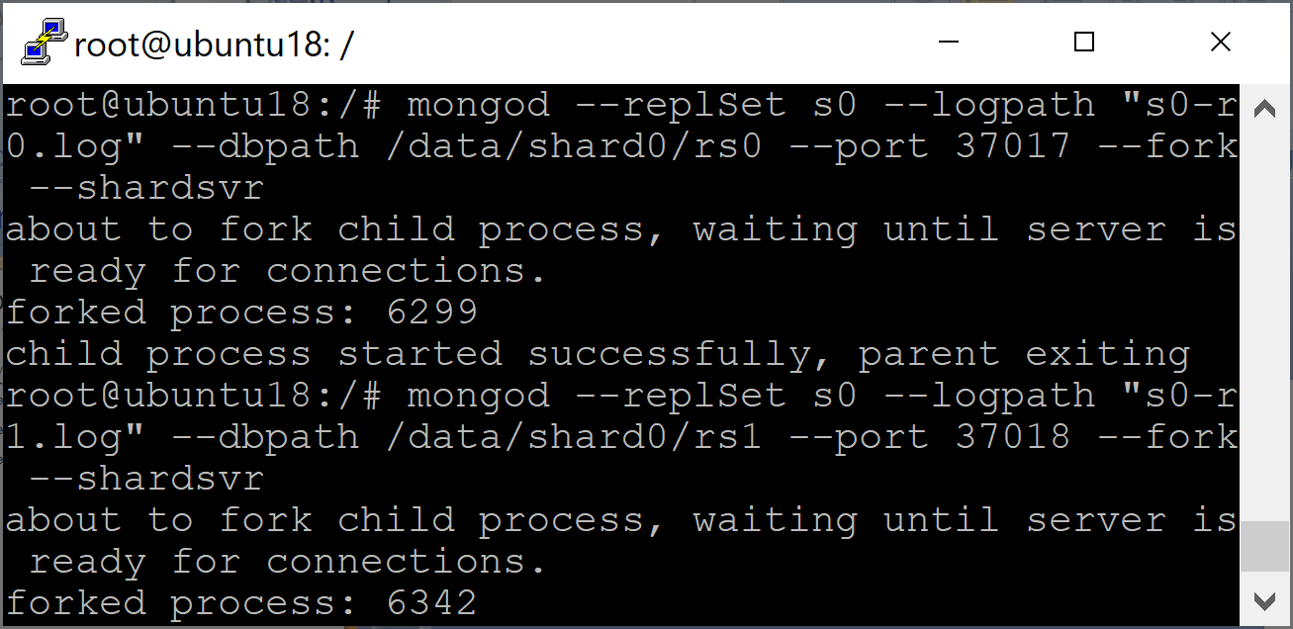
2. Start a Replica Set and Tell It That It Will Be shard0
echo "starting servers for shard 0"
mkdir -p /data/shard0/rs0 /data/shard0/rs1 /data/shard0/rs2
mongod --replSet s0 --logpath "s0-r0.log" --dbpath /data/shard0/rs0 --port 37017 --fork --shardsvr
mongod --replSet s0 --logpath "s0-r1.log" --dbpath /data/shard0/rs1 --port 37018 --fork --shardsvr
mongod --replSet s0 --logpath "s0-r2.log" --dbpath /data/shard0/rs2 --port 37019 --fork --shardsvr

Slide 65
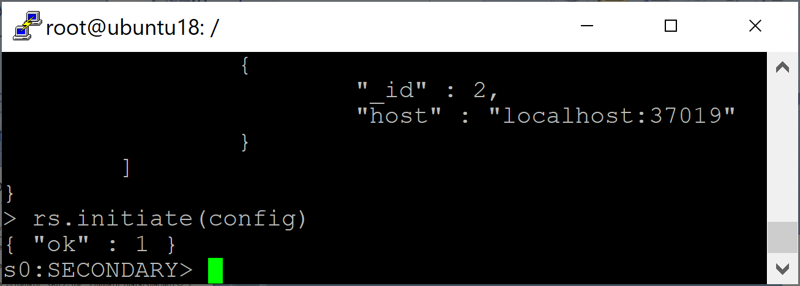
3. Connect to One Server and Initiate The Set
echo "Configuring s0 replica set"
mongo --port 37017
config = { _id: "s0", members:[
{ _id : 0, host : "localhost:37017" },
{ _id : 1, host : "localhost:37018" },
{ _id : 2, host : "localhost:37019" }]};
rs.initiate(config)
exit

Slide 66
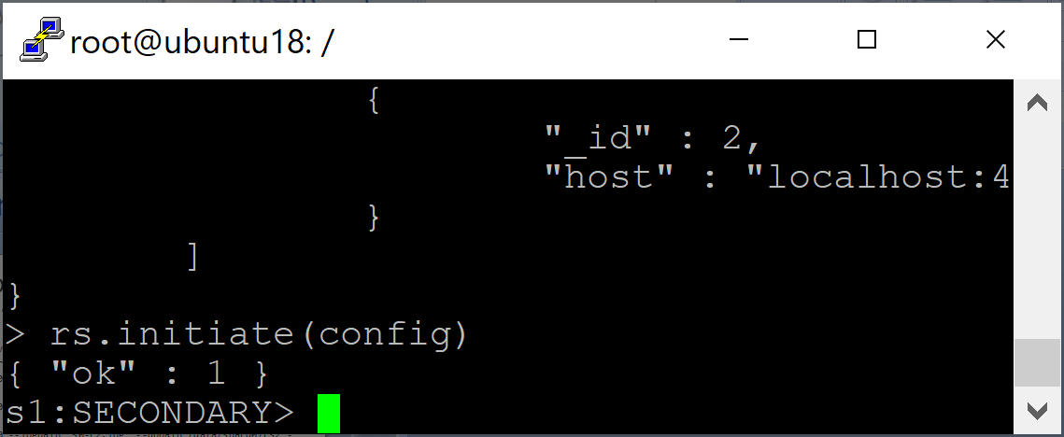
4. Start a Replica Set and Tell It That It Will Be shard1
echo "starting servers for shard 1"
mkdir -p /data/shard1/rs0 /data/shard1/rs1 /data/shard1/rs2
mongod --replSet s1 --logpath "s1-r0.log" --dbpath /data/shard1/rs0 -port 47017 --fork –shardsvr
mongod --replSet s1 --logpath "s1-r1.log" --dbpath /data/shard1/rs1 --port 47018 --fork –shardsvr
mongod --replSet s1 --logpath "s1-r2.log" --dbpath /data/shard1/rs2 --port 47019 --fork –shardsvr
echo "Configuring s1 replica set“
mongo --port 47017
config = { _id: "s1", members:[
{ _id : 0, host : "localhost:47017" },
{ _id : 1, host : "localhost:47018" },
{ _id : 2, host : "localhost:47019" }]};
rs.initiate(config)
exit

Slide 67
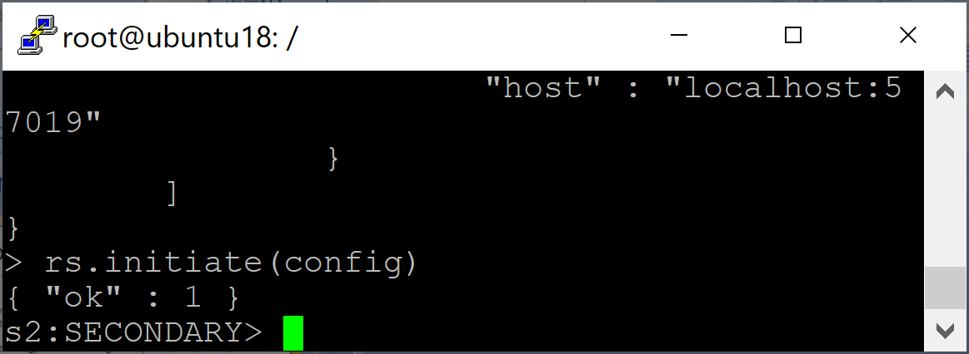
5. Start a Replica Set and Tell It That It Will Be shard2
echo "starting servers for shard 2"
mongod --replSet s2 --logpath "s2-r0.log" --dbpath /data/shard2/rs0 --port 57017 --fork --shardsvr
mongod --replSet s2 --logpath "s2-r1.log" --dbpath /data/shard2/rs1 --port 57018 --fork --shardsvr
mongod --replSet s2 --logpath "s2-r2.log" --dbpath /data/shard2/rs2 --port 57019 --fork --shardsvr
echo "Configuring s2 replica set"
mongo --port 57017
config = { _id: "s2", members:[
{ _id : 0, host : "localhost:57017" },
{ _id : 1, host : "localhost:57018" },
{ _id : 2, host : "localhost:57019" }]};
rs.initiate(config)
exit

Slide 68
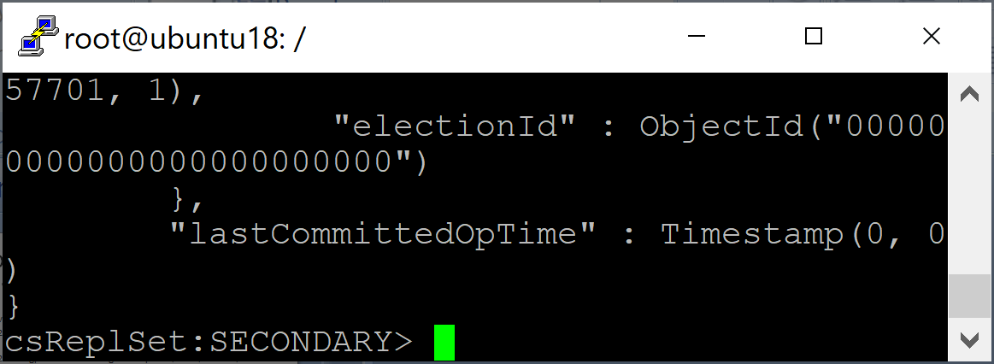
6. Start 3 Config Servers
echo "Starting config servers"
mkdir -p /data/config/config-a /data/config/config-b /data/config/config-c
mongod --replSet csReplSet --logpath "cfg-a.log" --dbpath /data/config/config-a --port 57040 --fork --configsvr
mongod --replSet csReplSet --logpath "cfg-b.log" --dbpath /data/config/config-b --port 57041 --fork --configsvr
mongod --replSet csReplSet --logpath "cfg-c.log" --dbpath /data/config/config-c --port 57042 --fork --configsvr
echo "Configuring configuration server replica set"
mongo --port 57040
config = { _id: "csReplSet", members:[
{ _id : 0, host : "localhost:57040" },
{ _id : 1, host : "localhost:57041" },
{ _id : 2, host : "localhost:57042" }]};
rs.initiate(config)
exit

Slide 69
7. Start the mongos on Port 27017
mongos --logpath "mongos-1.log" --configdb csReplSet/localhost:57040,localhost:57041,localhost:57042 --port 27017 --fork

Slide 70
8. Add shards and Enable sharding on the test db
mongo --port 27017
use admin
db.runCommand( { addshard : "s0/localhost:37017" } );
db.runCommand( { addshard : "s1/localhost:47017" } );
db.runCommand( { addshard : "s2/localhost:57017" } );
db.runCommand( { enableSharding: "test" } );
db.runCommand( { shardCollection: "test.users", key: { "email": "hashed" } } );

Slide 71
9. Write Data
mongo --port 27017
use test
for (i=0; i<100000; i++) {db.users.insert({"email": "email" + i, "password": "password" + i})}
db.users.count()
db.users.find()

Slide 72
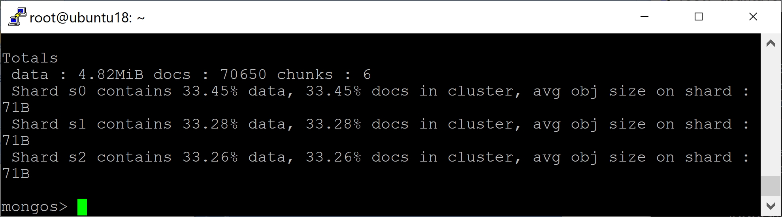
10. Verify Sharding
mongo --port 27017
db.users.getShardDistribution()

Slide 73

Thank You & See You Again

